Slide 1


Career in Data Science

Slide 2
Career Path in Data Science
Data Scientist
Chief Data Officer
Data Manager
Machine Learning Scientist
Statistician
Data Analyst (Junior /Senior)
Data Analytics Manager
Data Analytics Consultant
Analyst (Finance/Healthcare/Marketing/ System/Insurance claim)
Business Intelligence Analyst
Business Intelligence (BI) Developer
Data Engineer
Machine Learning Engineer
Data Architect
Architect (Applications /Enterprise/ Infrastructure)
Data Base Administrators

Slide 3
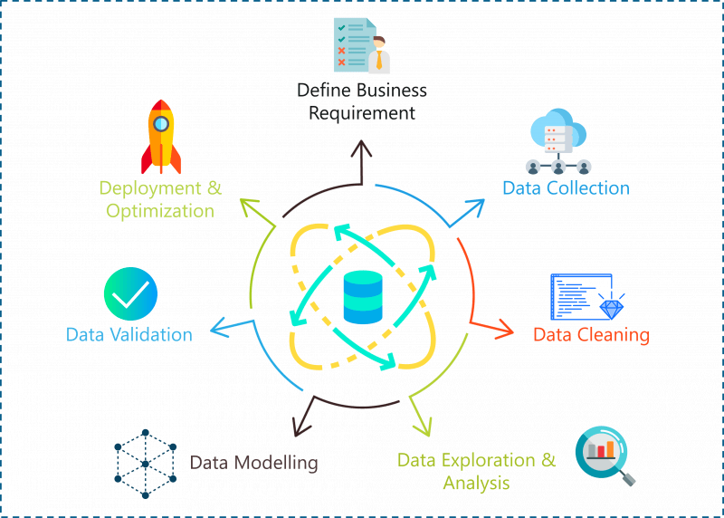
Phases in Data Science Project

Slide 4
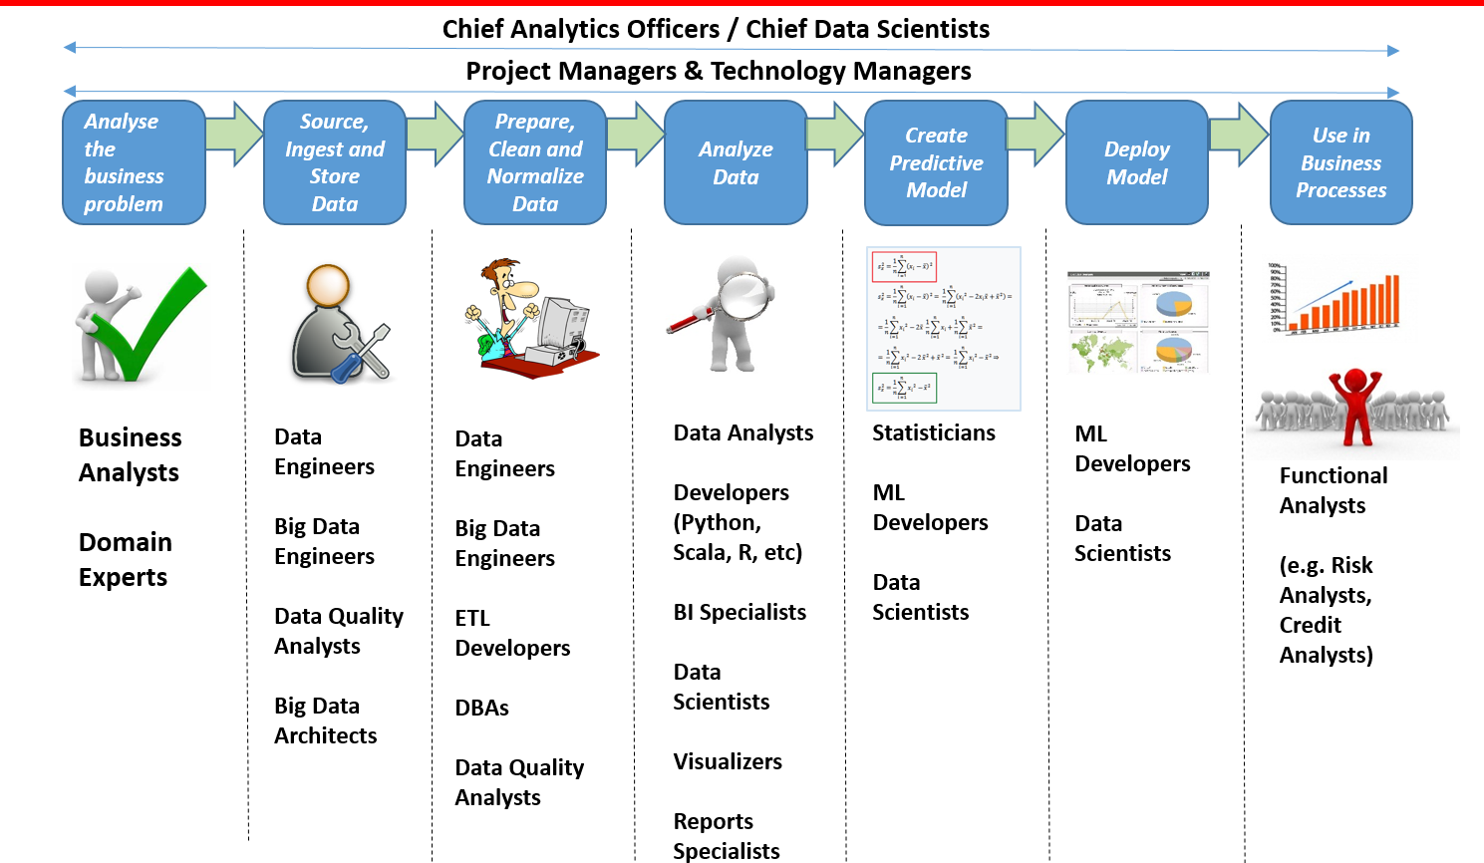
Roles / Teams involved in Data Science Industry IT project

Slide 5

Data Analyst vs Data Engineer vs Data Scientist
Let’s have a look inside

Slide 6
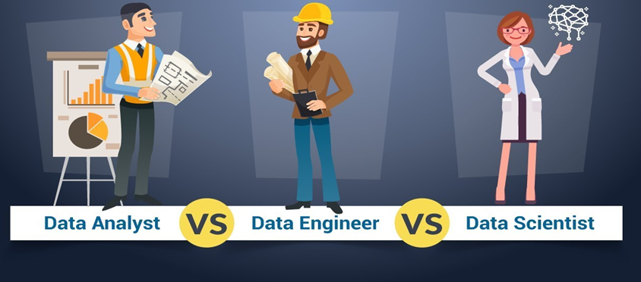
Career in Artificial Intelligence

Slide 7

Career in Artificial Intelligence
Data Engineer

Slide 8

Data Analyst
Gathers , investigates and Represents data in a understandable form
Responsible for Cleaning ,organizing and Transform raw data
Data Visualization is a part of their professional Day to day routine

Slide 9
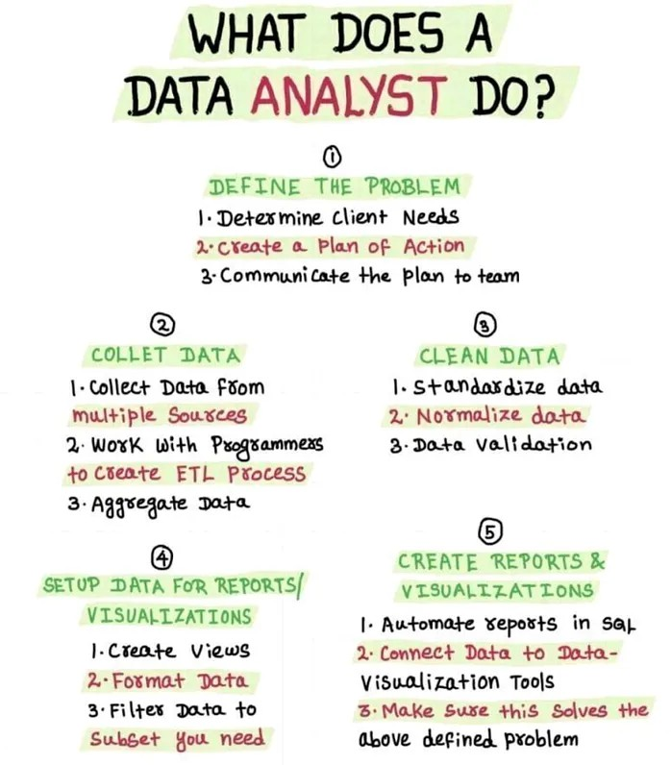

Slide 10
Jobs and Responsibilities
Data Analyst
Collect & interpret data from the Source
Analysing the results using statistical techniques
Acquire Data from primary and Secondary data Sources
Maintain Database/data systems
Data Mining, structure of raw data
Extract data to perform any type of research
Identify patterns and trends in data sets
Create Data dashboard , graphs and visualization

Slide 11
Data Engineer
Build and Optimize the systems for Data Scientist and Data Analyst
Construct Data pipelines for the organization’
Making Data is accessible to anyone who needs to work on it
Ensures that the data is properly received , transform and stored
To build infrastructure and framework necessary for data generation

Slide 12
Jobs and Responsibilities
Data Engineer
Develop,construct,test and maintain the architecture
Provide and implement the ways to improve the reliability, efficiency and quality of the data
To build the data pipelines
Creating and Integrating API’s
Develop the data set processes for data modelling, mining, and production

Slide 13
Data Scientist
Analyse the data strictly from a business point and the predicts
They deal with both Structure and Unstructured data
Resolve the business- related problems
Uses Machine Learning and Deep Learning extensively for prediction purpose

Slide 14
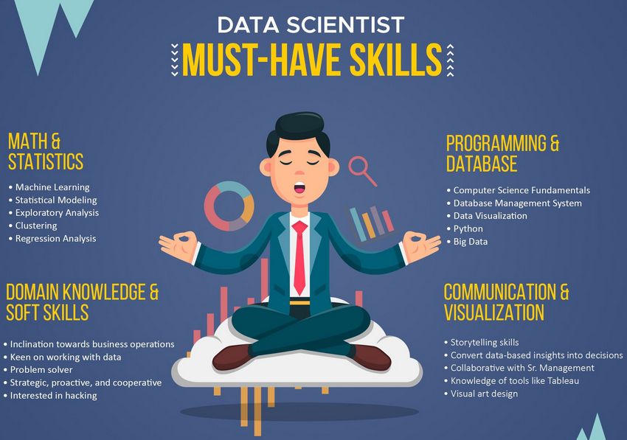
What company look for in a Data Scientist?

Slide 15

What people think about Data Scientist.

Slide 16
Jobs and Responsibilities
Data Scientist
Select features , build and optimize classifiers by using Machine Learning Techniques
Performing data mining and analysing by using the latest techniques
Perform proper data analysis by preprocessing , sorting and data integration
Develop data algorithms and Models
Perform predictive analysis using concepts of machine learning and predictive algorthims

Slide 17
Skill Set and Education Qualification
Data Analyst
Basic Programming Knowledge any of language such as R, python , SAS etc
SQL/Database Knowledge
Knowledge in any Data Visualization tool Such as Python, Tableau,Power BI
Computer science Preferred ( Not Mandatory)
Maths
Statistics
Information management and economics

Slide 18
Skill Set and Education Qualification
Data Engineer
Experience in Hadoop, MapReduce , pig, Hive Programming, Data Streaming
Database systems, with a knowledge in SQL, and No SQL Database
Computer Science ( Preferred)
Math and Statistics
Masters Degree could be more advantage

Slide 19
Skill Set and Education Qualification
Data Scientist
Requires strong business acumen and advanced Data Visualization competencies
Must have proficiency in any programming languages such as python, R ,C/C++ or SAS
Machine Learning and Deep Learning
Computer Science preferred
Math and Statistics
Masters or PhD Degree would add more advantage

Slide 20

Companies Hiring for Roles

Slide 21
I hope this information gives you an Overview about Data Science Job Roles

